Slide 1
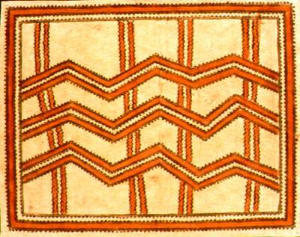
Bark cloth of the pacific preserving a Traditional Art
Part I of a research project compiled
By Sheri Majewski

Slide 2
Why this project is important to me:
This project is an initial step toward realization of community art involving tapa production and design
…
One of my goals is to become more involved with young people in my local community, to pass on the cultural heritage of Hawaiian kapa.
…
This research highlights traditional methods of teaching & learning that parallel the dynamic cognitive
theories of Lev Vygotsky and others. In particular:
-Working with a “More Knowledgeable Other”
-Working in a “Zone of Proximal Development”

Slide 3
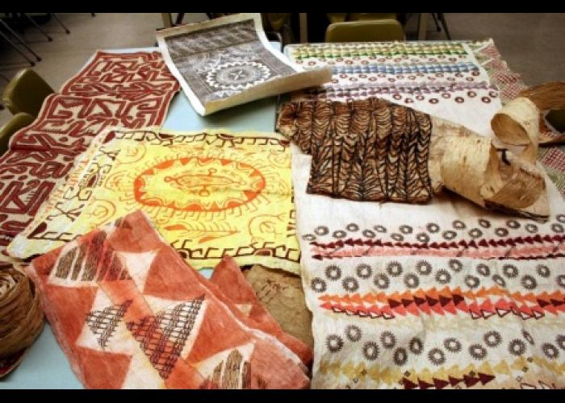
Commonly known as tapa, bark cloth is found throughout the Pacific Islands. The shared techniques and processes are evidence of vibrant cultural diffusion and historical relationships

Slide 4
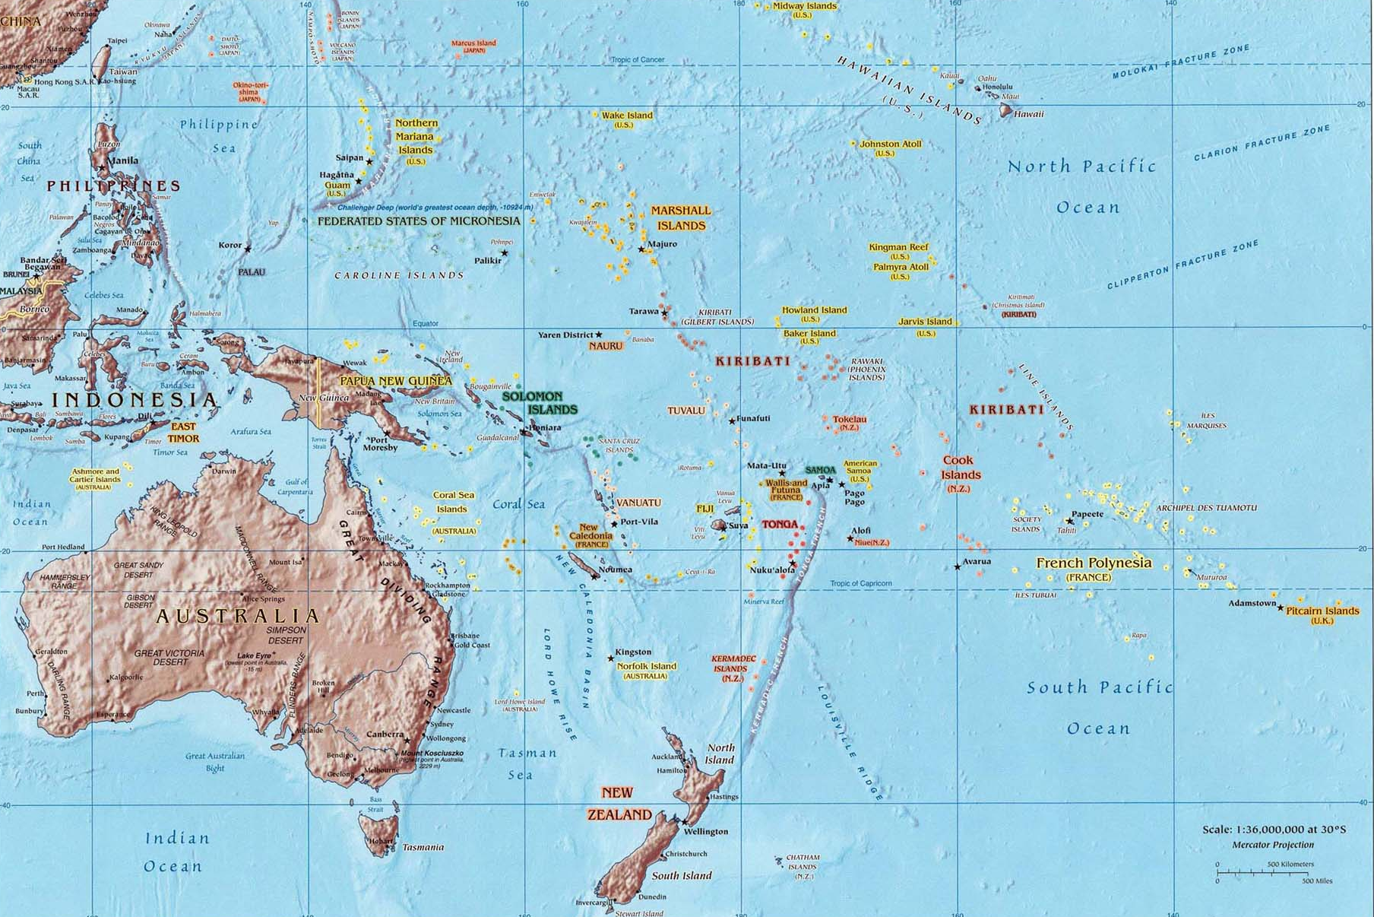
GEOGRAPHY OF THE PACIFIC OCEAN

Slide 5
Tapa is considered a sacred cultural element. It was used in nearly every aspect of a Pacific Islander’s daily life:
Clothing
Blankets
Lamps
Religious Practice
Prestigious Gifts
Funerals, Weddings, Births
Valued as a Sign of Wealth

Slide 6
Tapa almost became an extinct cultural practice.
After European Contact in the 18th century, textiles and other goods were adopted.

Slide 7
WHY IS IT IMPORTANT TO PRESERVE TRADITIONAL ART FORMS?
Preserving cultural heritage maintains diversity.
People are empowered by building their community and personal identity.
Cultural ways of learning are significant tools for educators.
Social interaction [through art] is a key to learning. Social learning precedes development.

Slide 8
Tonga and Samoa never completely stopped producing tapa. Large amounts are needed to commemorate investitures, funerals, and weddings.

Slide 9
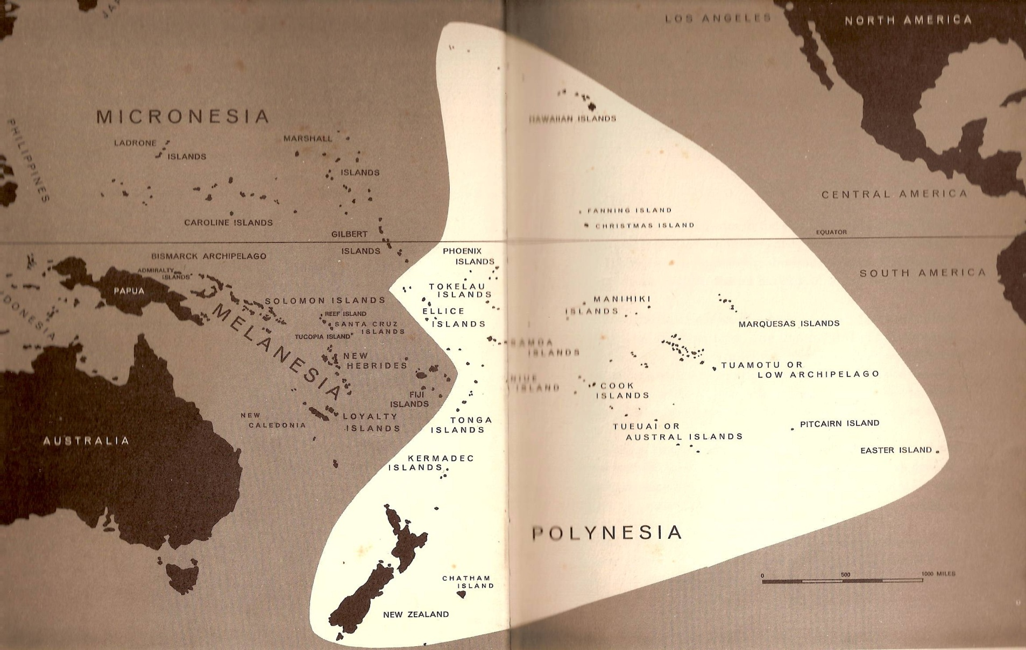
3 Pacific Island groups categorized by Europeans: Melanesia, Micronesia, Polynesia

Slide 10
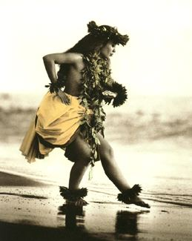
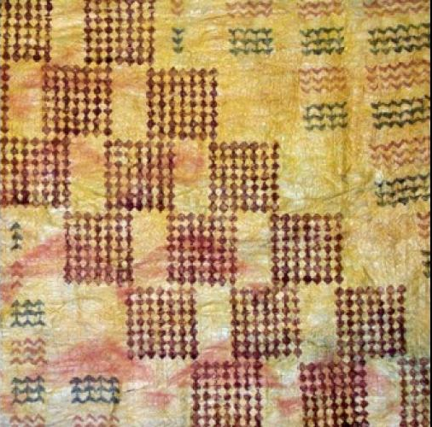
In the 1970’s, a cultural renaissance called on Tonga and Samoa to share their knowledge and expertise of tapa … This provided an authentic cultural authority in the revival of tapa as a traditional art … Island groups such as Hawai’i are reclaiming this traditional art and its historical legacy

Slide 11
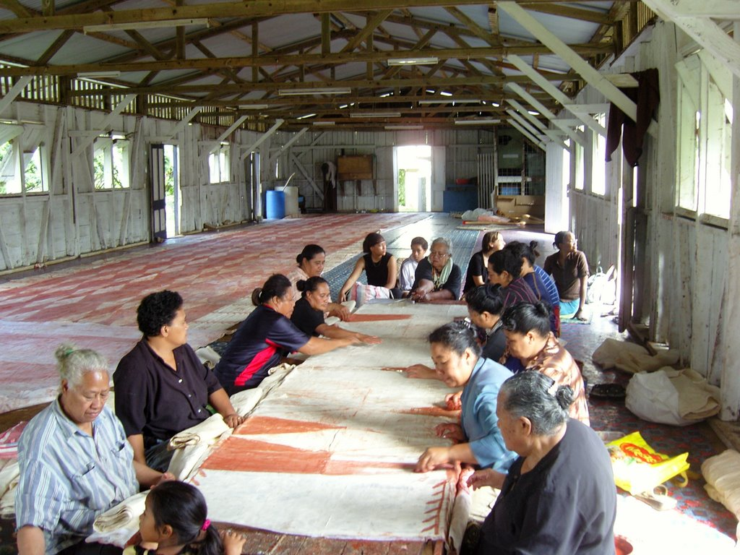
Women artists work communally to create this functional art and valuable artifact of material culture.

Slide 12
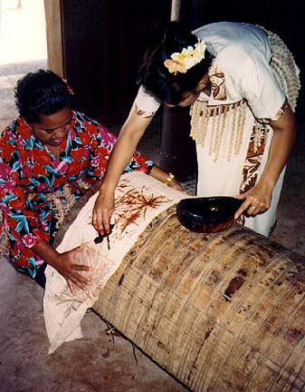
Knowledge of tapa is passed down orally … Learning environment is inter-generational … Learning environment is social … Socio-cultural constructs and values are perpetuated

Slide 13
REGIONAL NAMES for bark cloth & raw plant material

Slide 14
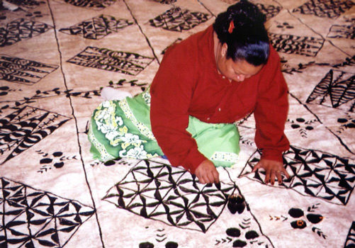
TONGAN TAPA is NGATU

Slide 15
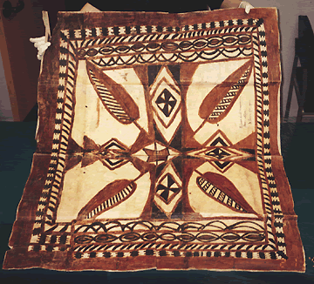
SAMOAN TAPA is SIAPO

Slide 16
FIJIAN TAPA is MASI

Slide 17
SOCIETY ISLANDS TAPA is AHU

Slide 18
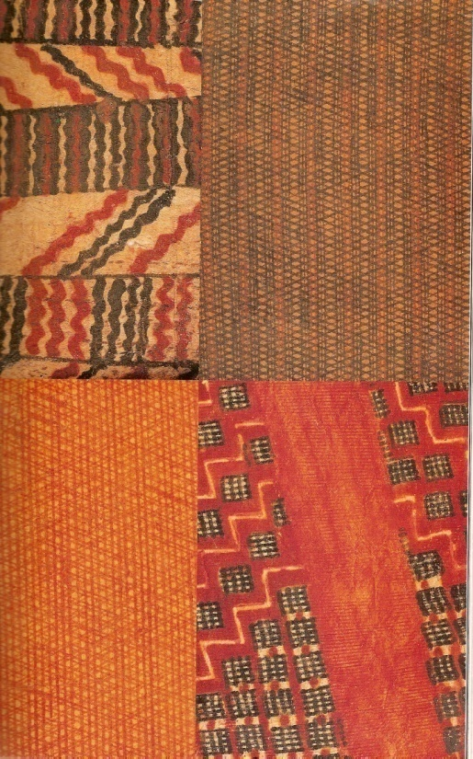
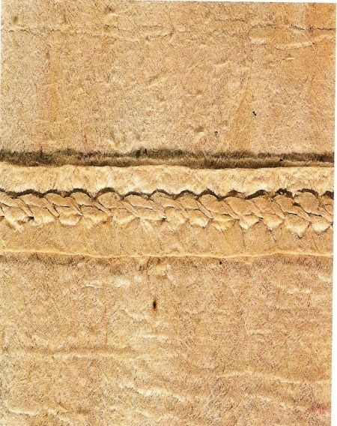
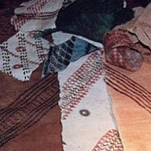
HAWAIIAN TAPA is KAPA

